Slide 1




Predictive Analysis of Income
Group F
Roshik Ganesan | Mittal Vaghela | Kaustubh Padhya | Manali Joshi
Mentor- Dr. Jongwook Woo

Slide 2
Contents
Introduction
Objective
Pre-requisites
Feature Selection
AzureML Model Building
Azure Result Comparison
References
SparkML process flow
SparkML Model Building
Result Comparison- AzureML Vs SparkML
Summary
Limitations & Problems Faced

Slide 3
Introduction
The datasets contain employee salary information of 3 major cities in the United States
  Los Angeles
  San Francisco
  New York.
Sample features:
  Department
  Job role
  Basic pay
  Gross pay
  Overtime pay
  Medical benefits

Slide 4
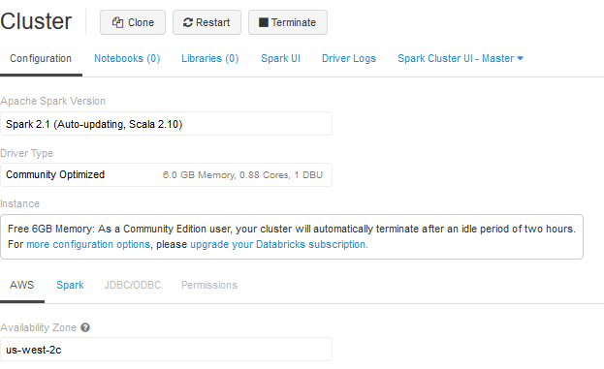
Hardware Specification & Data Set Details
Apache Spark Version – Spark 2.1 (Auto-updating, Scala 2.10)
Memory – 6GB Memory, 0.88 Cores, 1 DBU
File System – DBFS (Data Bricks File System)

Slide 5
Data Set Details
Dataset Name: LA County Employee Salary, Employee Compensation SF, Salary Information of State Authorities - NY
Dataset Format: CSV
Dataset Size: 210MB
https://data.lacounty.gov/Operations/LA-County-Employee-Salaries/8rdv-6nb6
https://catalog.data.gov/dataset/employee-compensation-53987
https://data.ny.gov/Transparency/Salary-Information-for-State-Authorities/unag-2p27

Slide 6
Objective and Algorithms
The aim of our project is to predict the Income and Department of an employee based on the available features form the dataset by utilizing Machine learning Algorithms and build accurate models using AzureML and SparkML.
List of Machine Learning Algorithms used:-
Boosted Decision Tree Regression
Decision Forest Regression
GBT Regression
Multiclass Logistic Regression
Multiclass Neural Networks

Slide 7
Pre-requisites
AzureML account.
Databricks Community Edition account
Knowledge of Machine Learning Algorithms.
Knowledge of AzureML, SparkML and Python.

Slide 8
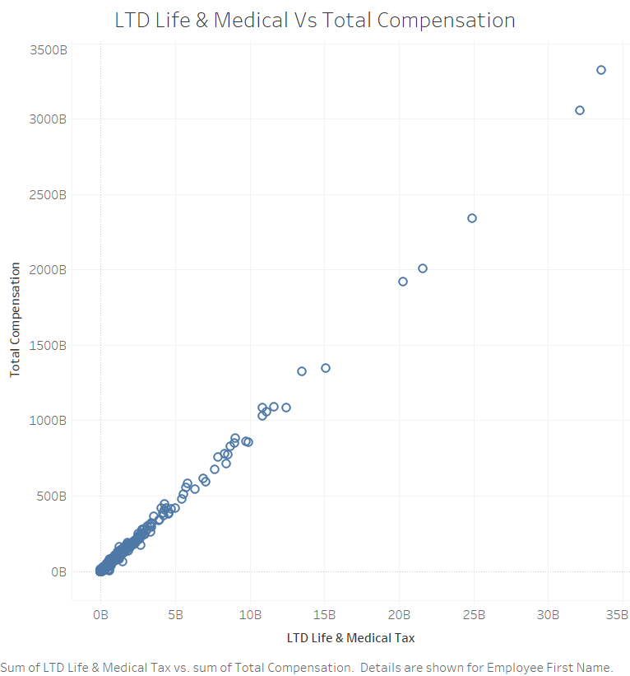
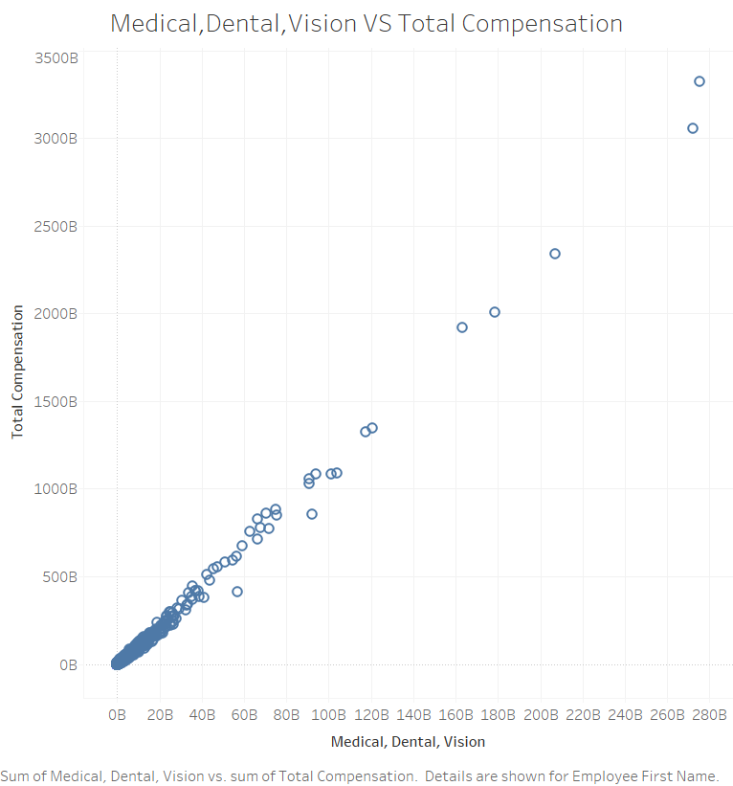
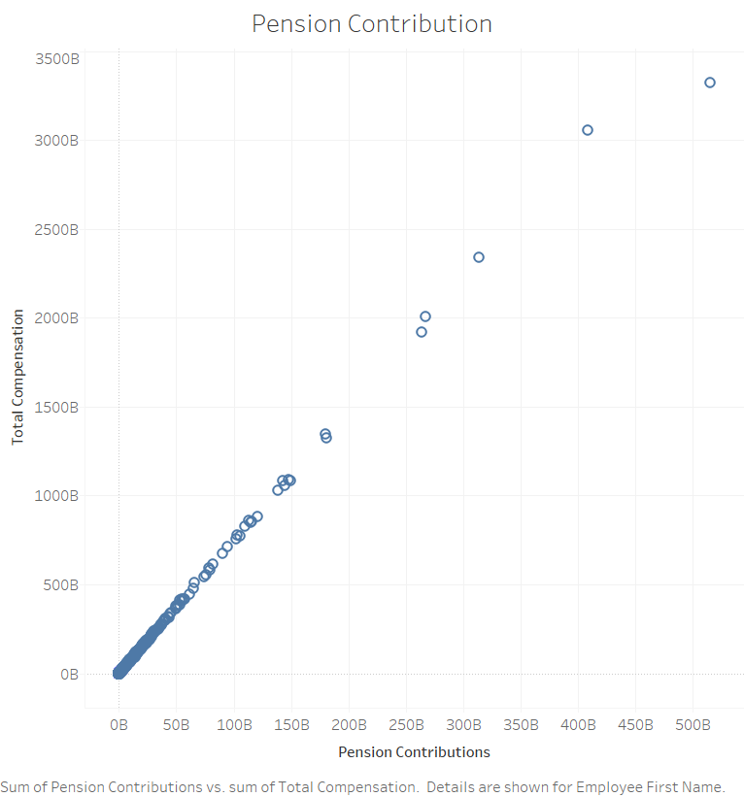
Feature selection Analysis - LA
LTD Life and Medical
Medical dental Vision
Pension Contribution

Slide 9
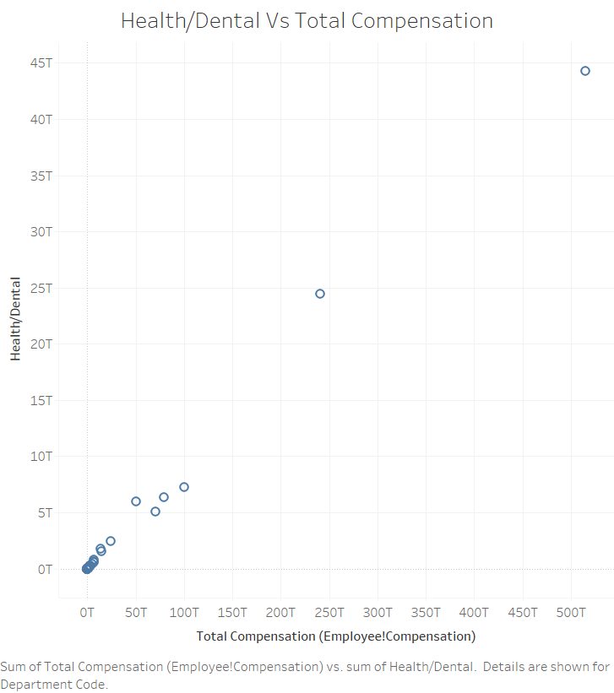
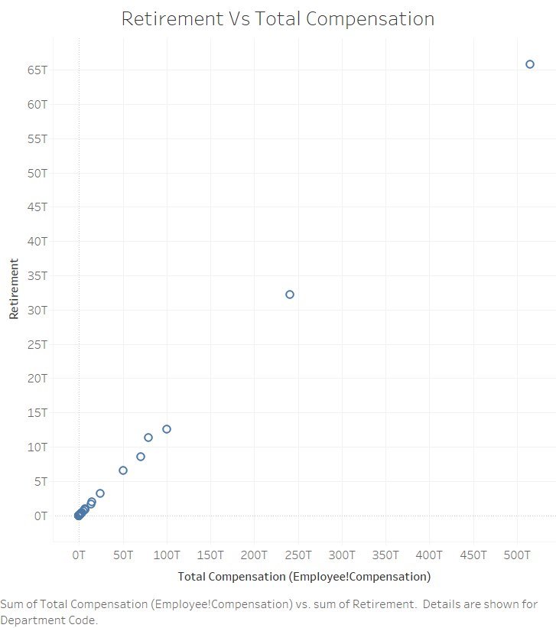
Feature selection Analysis – San Francisco
Health/Dental
Retirement

Slide 10
AzureML Model Building - Regression
Load Data
Select Columns
Clean Missing Data
Clip Values
Split Data
Algorithm
Train + Score + Evaluate

Slide 11
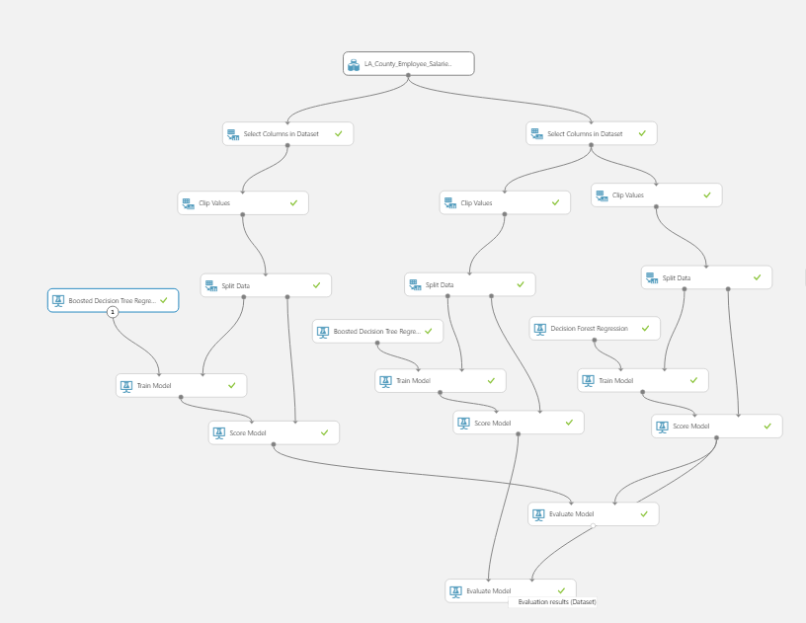
Model 1- LA City

Slide 12
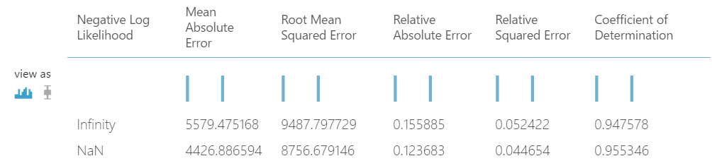
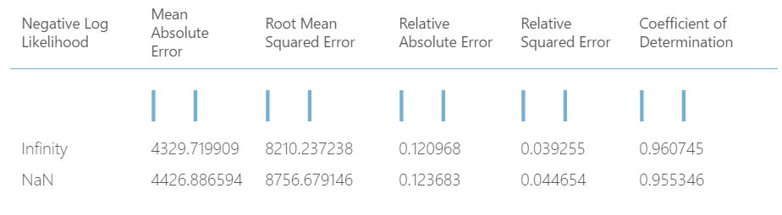
Model 1 - Result Comparison
2. Decision Forest Regression:
1. Boosted Decision Tree Regression:
3. Boosted Decision Tree Regression:
Columns: Total Compensation, Medical/Dental/Vision, Pension Contributions.
Clip Values: 90th Percentile upper threshold,20th Percentile lower threshold.
RMSE= 9487.7977
COD= 0.947578
Columns:Medical/Dental/VisionTotal Compensation, LTD Life &MedicalTax, Pension Contributions.
Clip Values: 90th Percentile upper threshold, 20th Percentile lower threshold.
RMSE= 8756.679146
COD= 0.955346
Columns:Medical/Dental/VisionTotal Compensation, LTD Life &MedicalTax, Pension Contributions.
Clip Values: 90th Percentile upper threshold, 20th Percentile lower threshold.
RMSE= 8210.2372
COD= 0.960745

Slide 13
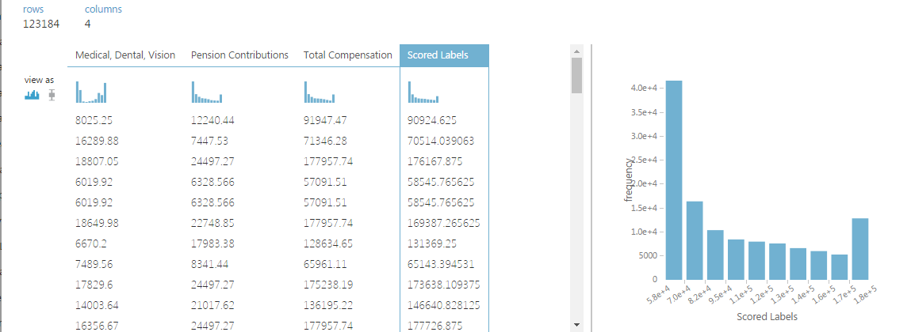
Boosted Decision Tree Regression

Slide 14
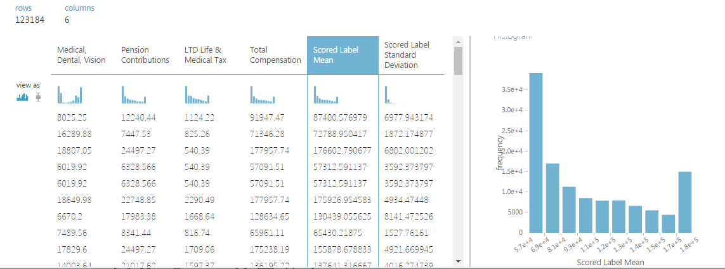
Decision Forest Regression

Slide 15
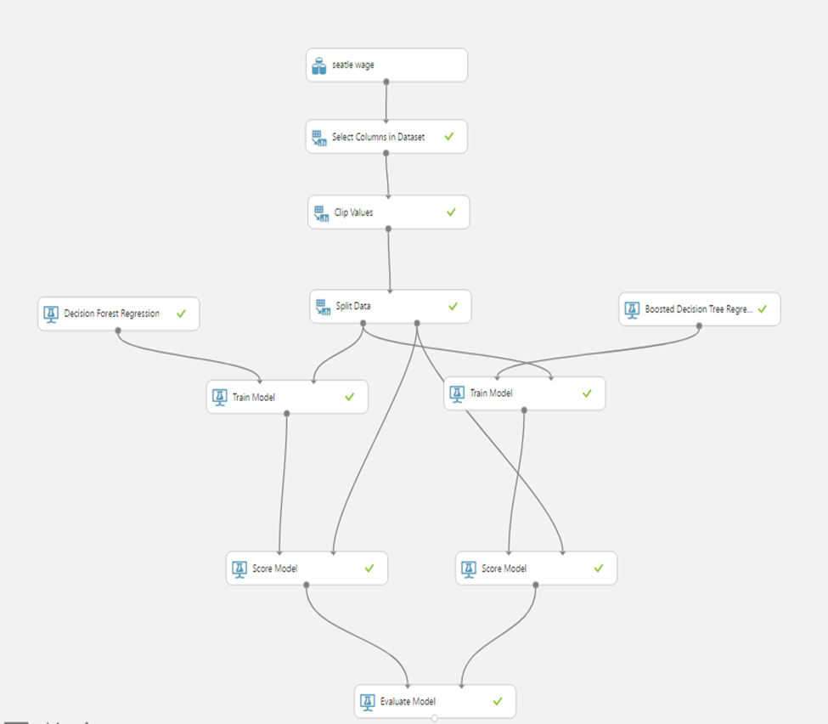
Model 2- San Francisco

Slide 16
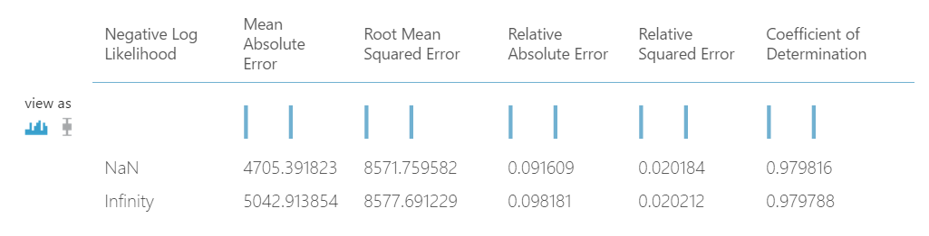
Model 2- San Francisco
1. Boosted Decision Tree Regression:
Columns: Retirement, Salaries, Health/Dental,Total Compensation
Clip Values: 90th Percentile upper threshold, 20th Percentile lower threshold.
RMSE= 8571.7595
COD= 0.979861
2. Decision Forest Regression:
Columns: Retirement, Salaries, Health/Dental,Total Compensation
Clip Values: 90th Percentile upper threshold, 20th Percentile lower threshold.
RMSE= 8577.69122
COD= 0.979788

Slide 17
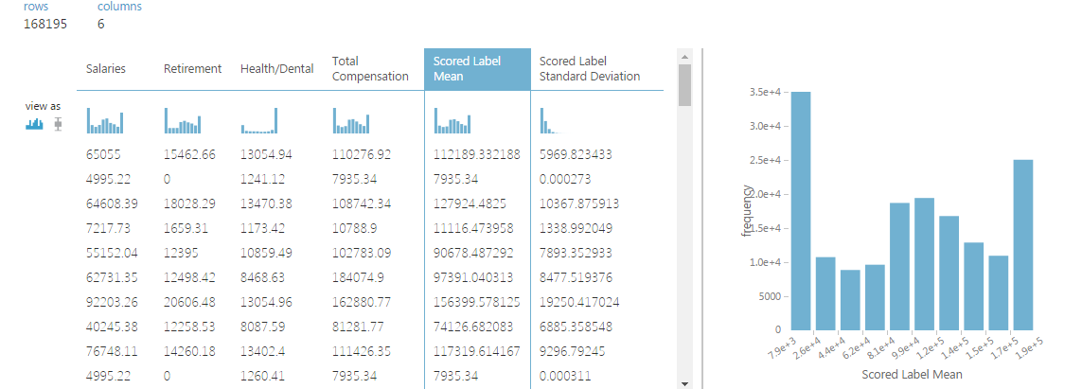
Decision Forest Regression

Slide 18
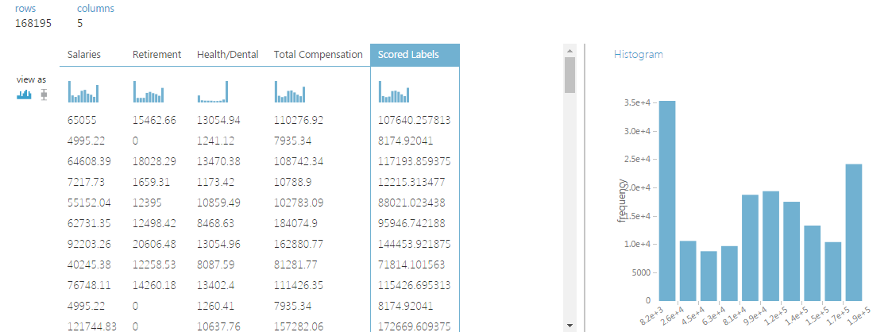
Boosted Decision Tree Regression

Slide 19
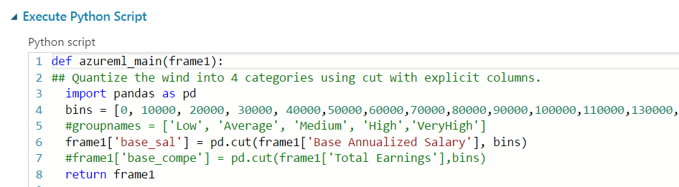
AzureML Model Building – Classification
Load Data
Select Columns
Clean Missing Data
Clip Values
Split Data
Algorithm
Train + Score + Evaluate
Execute Python Script

Slide 20
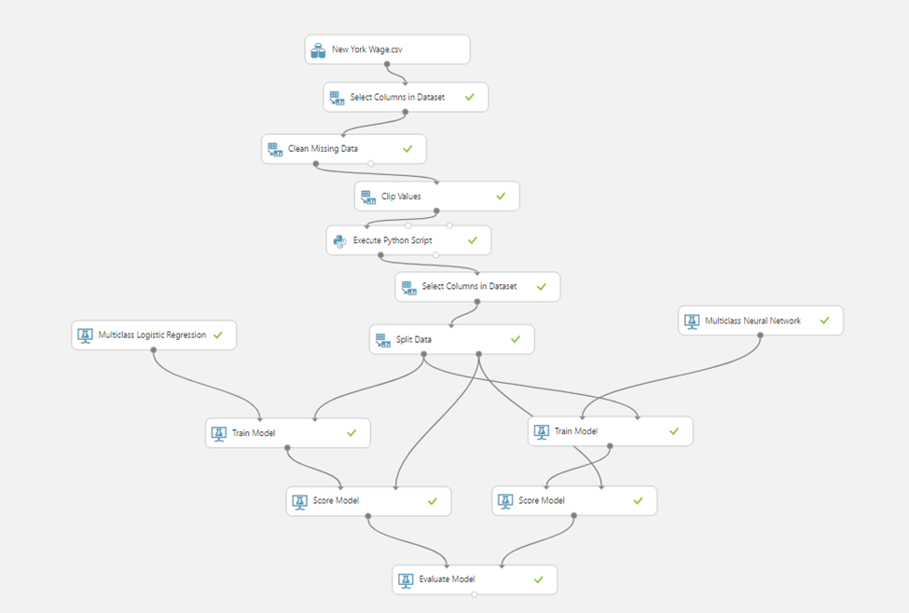
Model 3- New York
1. Multiclass Logistic Regression:
Columns: Group, Title, base_sal
Overall accuracy= 0.894895
Average accuracy= 0.964965
Micro-averaged precision= 0.894895
Macro-averaged precision= 0.855637
Micro-averaged recall= 0.894895
Macro-averaged recall= 0.713172
2. Multiclass Neural Networks:
Columns: Group, Title, base_sal
Overall accuracy= 0.91391
Average accuracy= 0.971303
Micro-averaged precision= 0.91391
Macro-averaged precision= 0.878639
Micro-averaged recall= 0.91391
Macro-averaged recall= 0.797034

Slide 21
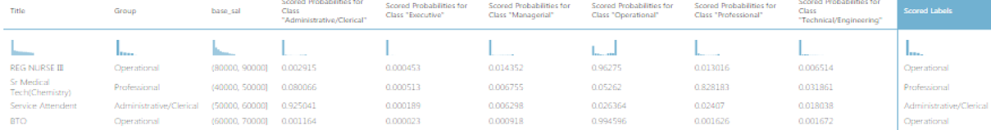
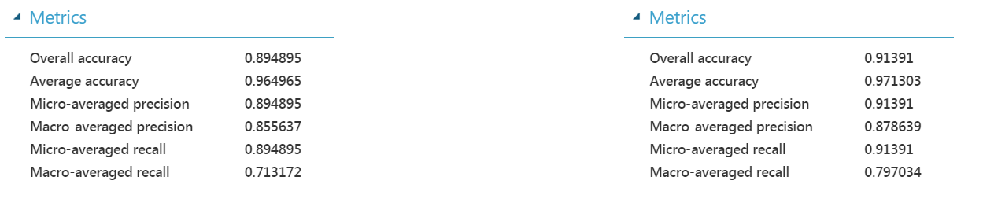
Multiclass Neural Networks Vs Multiclass Logistic Regression

Slide 22
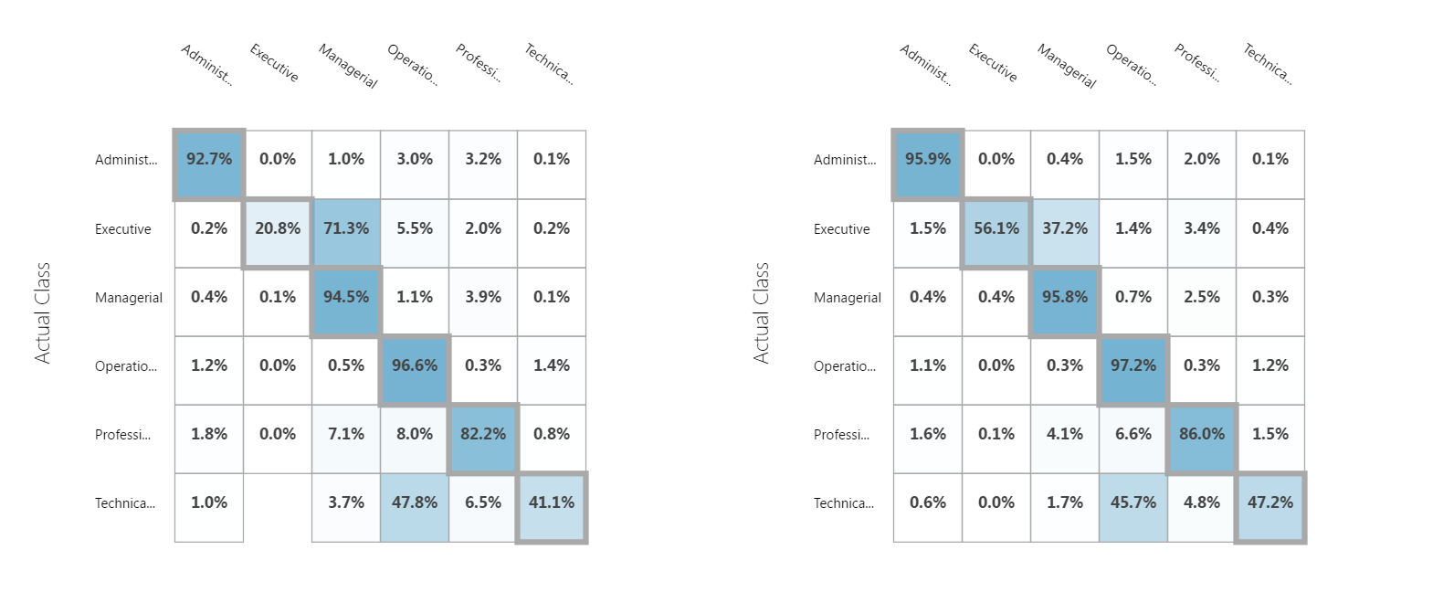
Multiclass Neural Networks Vs Multiclass Logistic Regression

Slide 23
Azure Result Comparison
LA
BDTR
RMSE= 8210.2372
COD= 0.960745
DFR
RMSE= 8756.679146
COD= 0.955346
SF
BDTR
RMSE= 8571.7595
COD= 0.979861
DFR RMSE= 8577.69122
COD= 0.979788
NY
MLR
Average accuracy= 0.964965
Macro-averaged precision 0.855637
Macro-averaged recall 0.713172
MNN
Average accuracy= 0.971303
Macro-averaged precision 0.878639
Macro-averaged recall 0.797034

Slide 24
SparkML process flow
Load Data
Feature Extraction
Clip & Remove outliers
Fit/Train
Transform/Test
Evaluator
Split Data
Algorithm
Cross Validator
Import Spark Libraries

Slide 25
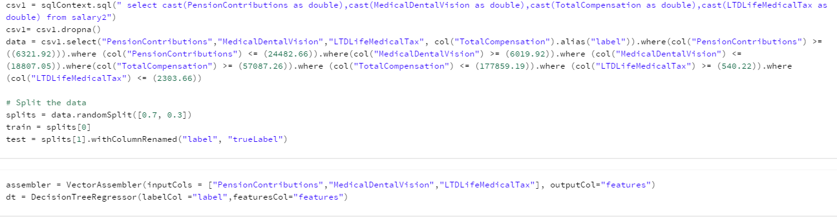
Spark ML Model- LA city Income
Algorithms used: Decision Tree Regressor and GBT Regressor
Features used: Pension, MedicalDentalVision and LTDLifeMedicalTax
Label Predicted: Total Compensation
Code snippet of Decision Tree Regressor

Slide 26
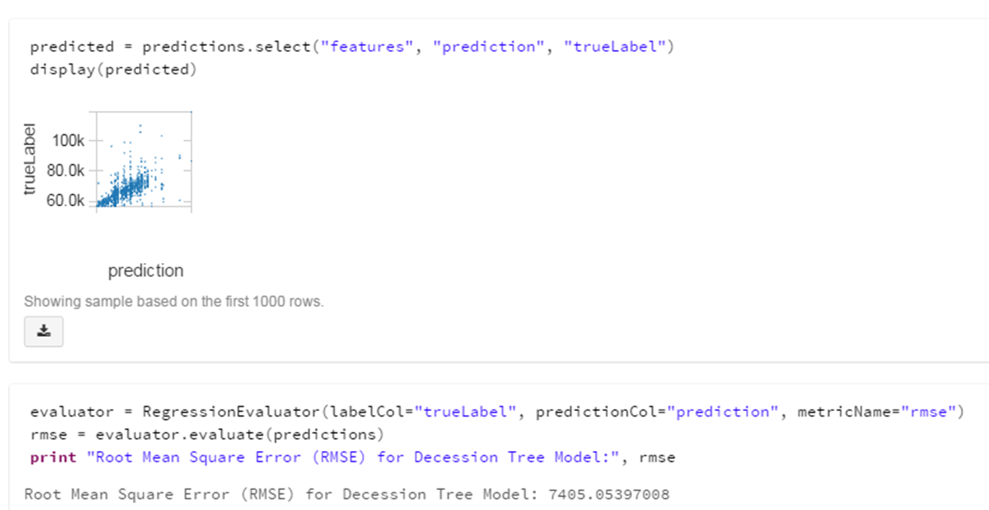
Decision Tree Regressor - RMSE
The Root Mean Square Error (RMSE) of LA city incomes using Decision Tree Regressor Algorithm is 7405.053

Slide 27
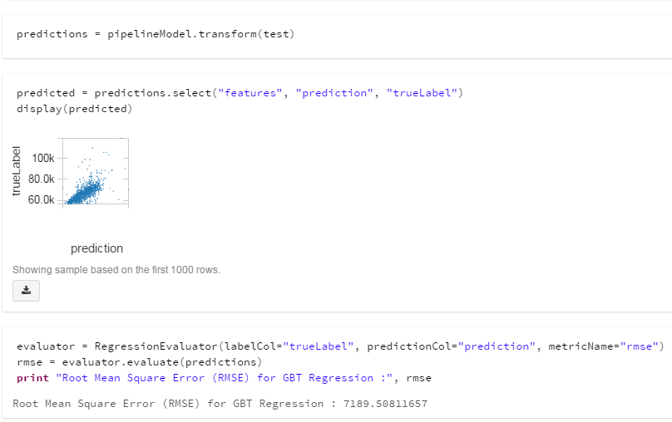
GBT Regressor RMSE
The Root Mean Square Error (RMSE) of LA city incomes using GBT Regressor Algorithm is 7189.508

Slide 28
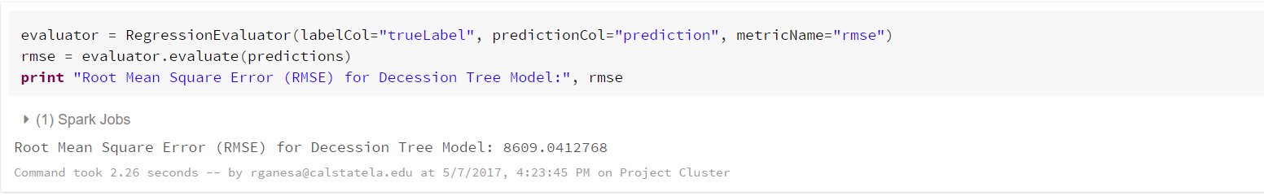
Spark ML Model- SF City Income
Features used: Salaries, Retirement and Health/Dental
Label Predicted: Total Compensation
Root Mean Square Error (RMSE) for Decision Tree Model is 8609.04

Slide 29
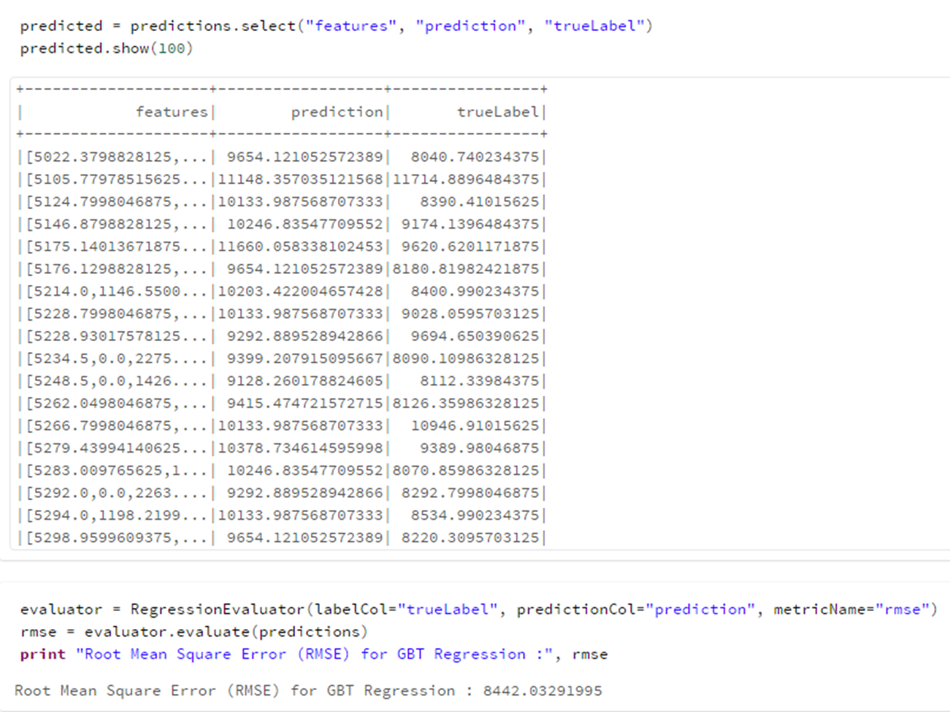
GBT Regression - RMSE
Root Mean Square Error (RMSE) for GBT Regression is 8442.032
Better than the Decision Tree Regressor. Hence, we choose this model for the purpose of Income Prediction.

Slide 30
Result Comparison- AzureML Vs SparkML
 | AzureML |  | SparkML
 | Boosted Decision Tree Regression | Decision Forest Regression | Decision Tree Regressor | GBT Regressor
Los Angeles | 8210.2372 | 8756.679 | 7405.053 | 7189.508
San Francisco | 8571.7595 | 8577.69122 | 8609.04 | 8442.032
Note: Evaluation Metric used is RMSE (Root Mean Square Error)

Slide 31
Summary
Based on selected features predictive analytics was conducted to predict the Total Compensation of employees working in following cities.
  Los Angeles
    LTD Life and Medical
    Medical,Dental,Vision
    Pension Contribution
  San Francisco
    Health/Denal
    Retirement
Using the title and the base compensation the department of the employee in New York is predicted.
Comparison between models in Azure ML and Spark ML is done and it is found that Spark’s GBT Provides the best predictive values.

Slide 32
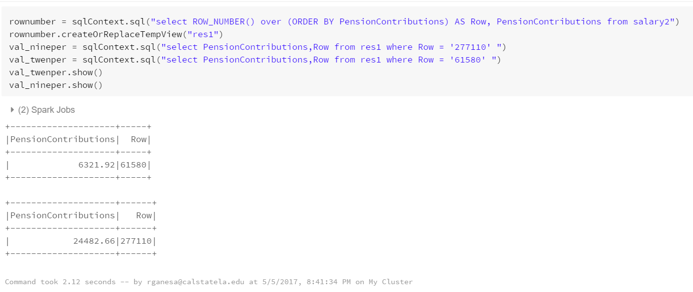
Limitations & Challenges Faced
Azure ML doesn’t allow to specify the schema after uploading the data.
Using Neural Network for classification takes a long time to train the model though it gives better prediction.
Spark ML does not provide a clip value module as done by Azure ML:
  A custom module was developed with appropriate logic to clip the 90th and 10th percentile values.

Slide 33
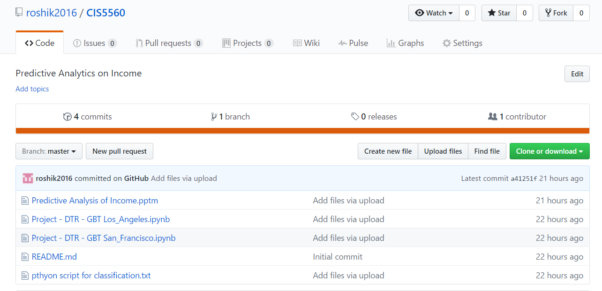
GitHub Upload
https://github.com/roshik2016/CIS5560

Slide 34
References
https://spark.apache.org/docs/2.1.0/ml-classification-regression.html
https://docs.microsoft.com/en-us/azure/machine-learning/machine-learning-model-progression-experiment-to-web-service
https://docs.microsoft.com/en-us/azure/machine-learning/machine-learning-evaluate-model-performance
https://datasciencedojo.com/building-classification-model-azure-machine-learning-studio/

Slide 35
THANK YOU
Questions Session

